Slide 1

BYUI CIT225 - Database Design & Development BEHAVIORAL Healthcare DB
Monique Roberts
CIT225 - Final
July 14, 2023

Slide 2

DATABASE Introduction
This database is for Behavioral healthcare administrators, counselors and social workers to maintain their client lists, record service dates, and enter billing. This business model was setup with 3 UI interfaces. These 3 portal pages allow users to query, update and add new rows of data for:
Clients
Billing
Servicing Dates

Slide 3
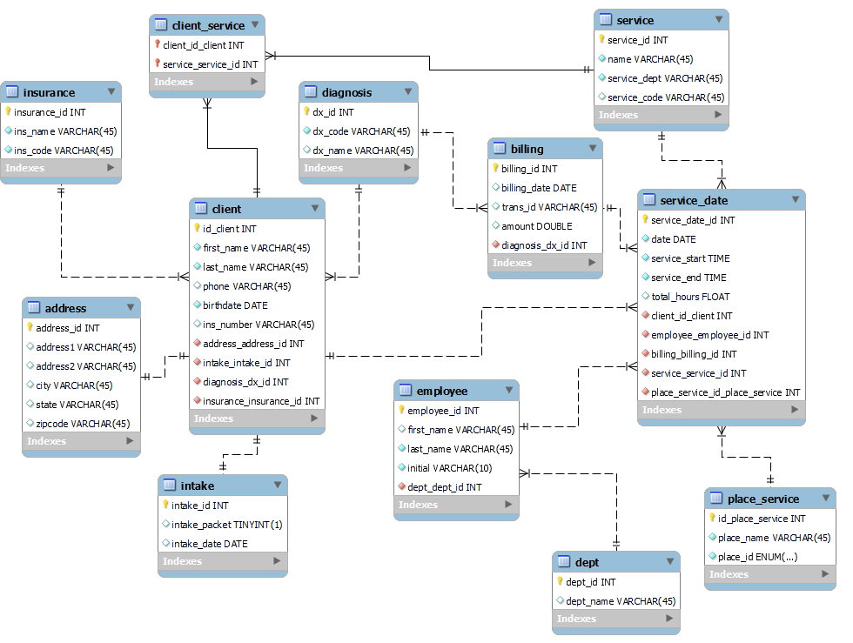
Behavioral Health Billing Portal - ERD

Slide 4
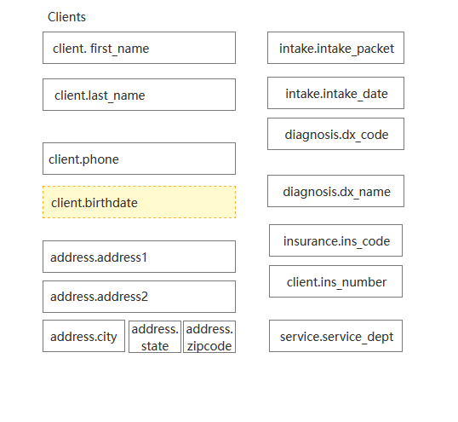
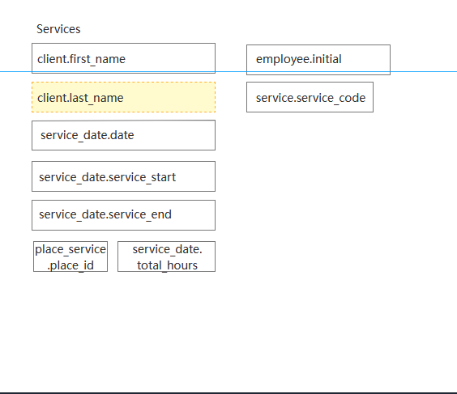
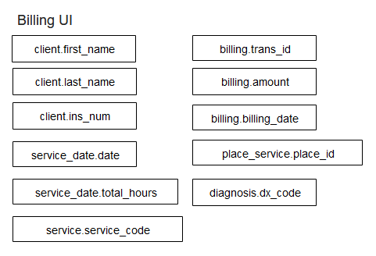
UI Mockups
These are basic mockups of the 3 UI Portals, where users will be looking up and adding new data.

Slide 5
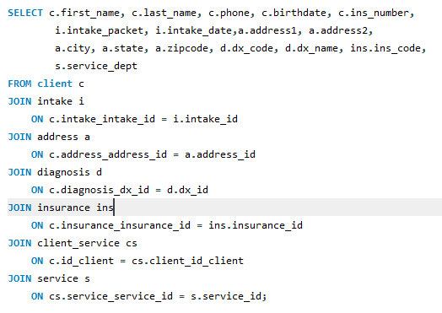
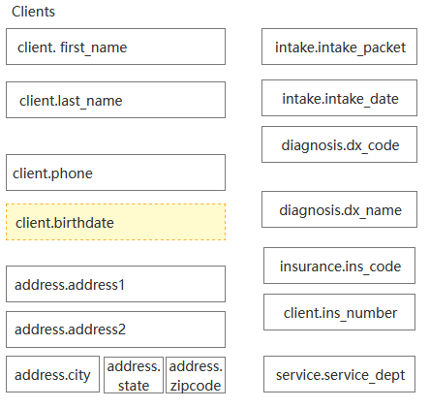
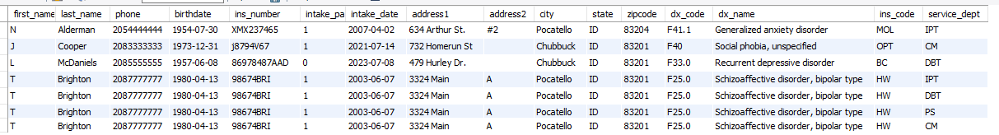
CLIENT UI
CLIENT SELECT QUERY
CLIENT PORTAL
SELECT QUERY RESULT SET

Slide 6
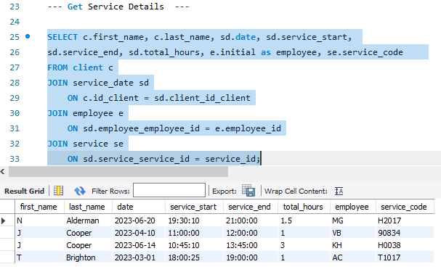
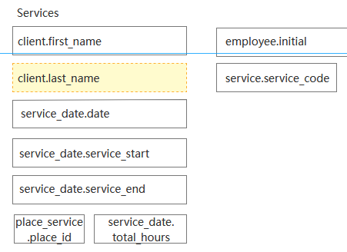
SERVICE DATE UI
This portal is for workers to record entries after they have worked with a client.
SERVICE DATE SELECT QUERY
SERVICE DATE PORTAL
SELECT QUERY RESULT SET

Slide 7
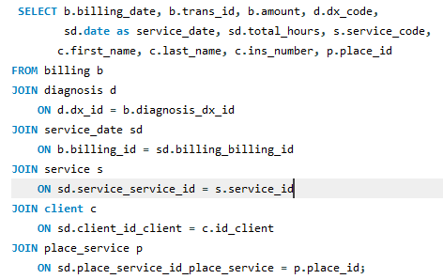
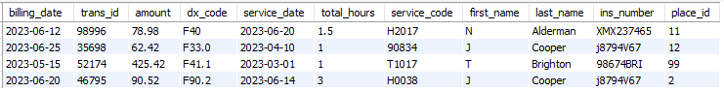
BILLING UI
This portal is for administrators to add and view billing details.
BILLING SELECT QUERY
BILLING PORTAL
SELECT QUERY RESULT SET

Slide 8
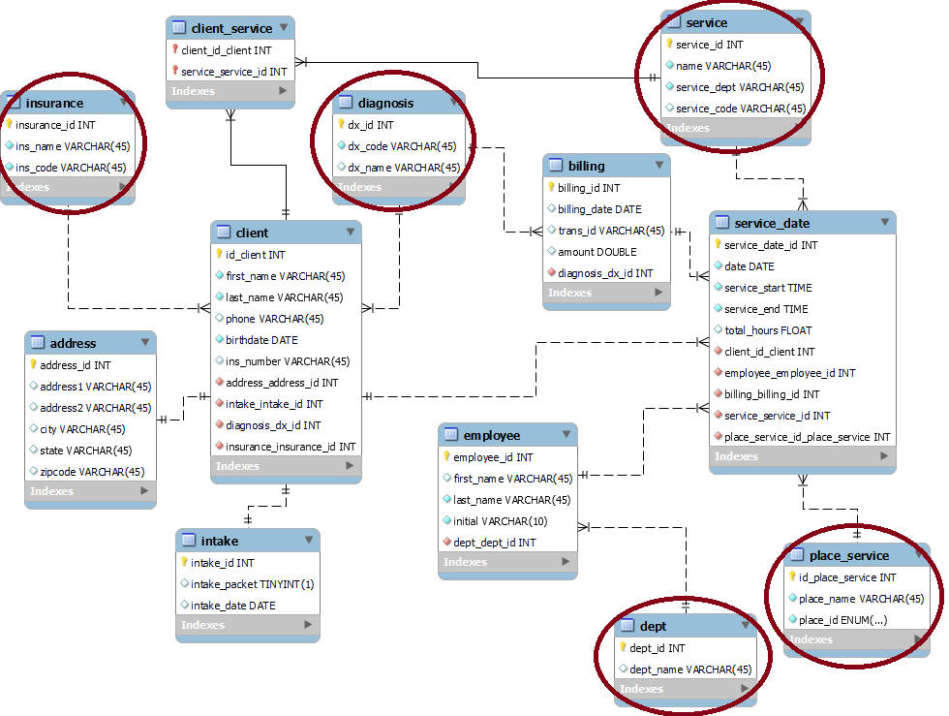
Supporting Tables
Data can be viewed, updated and added through the 3 user interfaces. All the other tables are just to support the interfaces and it is assumed this data is entered initially and does not change often. Therefore there are no user portals for the other tables

Slide 9
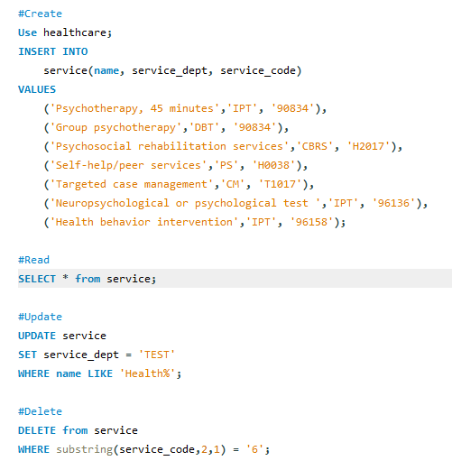
CRUD TEST CASES
There are CRUD test cases on all 12 tables.
Here is an example of CRUD on the service table.

Slide 10



Thank you
Monique Roberts - CIT225 - Final Project

